Slide 1
Crosstown Phase II Update #6 Presentation to ANC 1A Aaron Goldbeck, DDOT 3/22/22

Slide 2
Agenda
Project History & Overview
Warder Update
Park Pl & Park Rd Plans
Kenyon Plans
Q&A, Feedback on Park Pl & Park Rd
Q&A, Feedback on Kenyon

Slide 3
Project Overview
Parking Protected Bike Lanes built on Park Pl, Kenyon St, and Warder St NW
Conversion of one travel lane on Park Pl to parking
Conversion of Park Rd to one-way westbound, parking added to south side of street
Removal of rush hour parking on Kenyon
Net parking gain in neighborhood

Slide 4
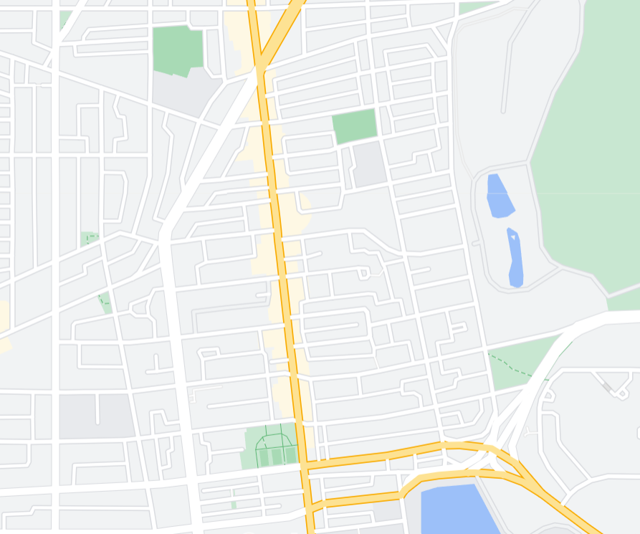
Crosstown Phase II Map
Existing protected bike lanes
New protected bike lanes
One-way conversion (westbound)
Streets planned for freight and transit (bus)
Warder
Park Pl
Park Rd
Kenyon
Irving
Columbia
5th St.

Slide 5
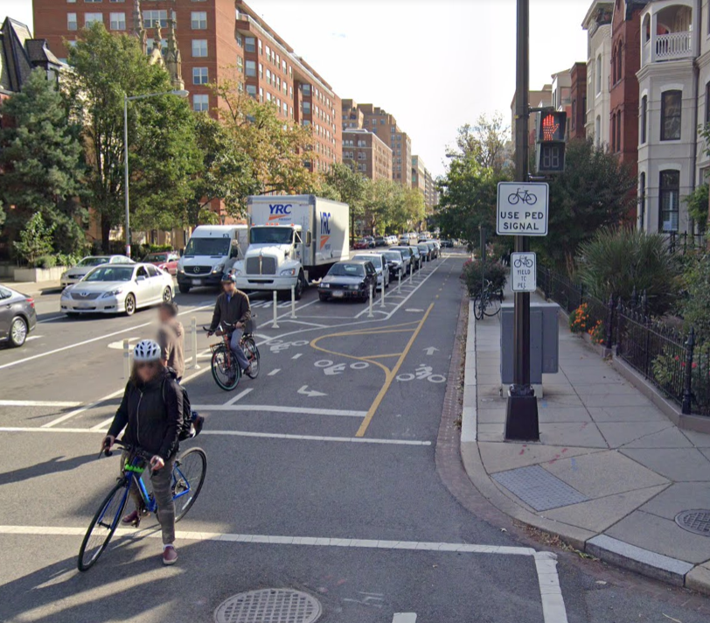
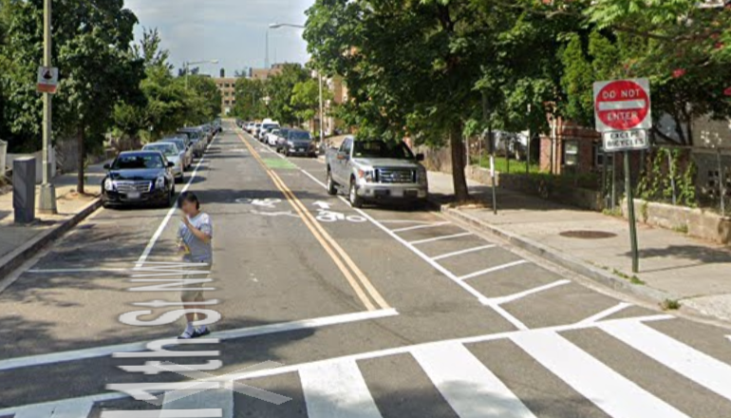
Project Concept
Left: parking protected bike lane (Warder, Park Pl, Kenyon)
Below: Counter-flow bike lane (Park Rd)

Slide 6
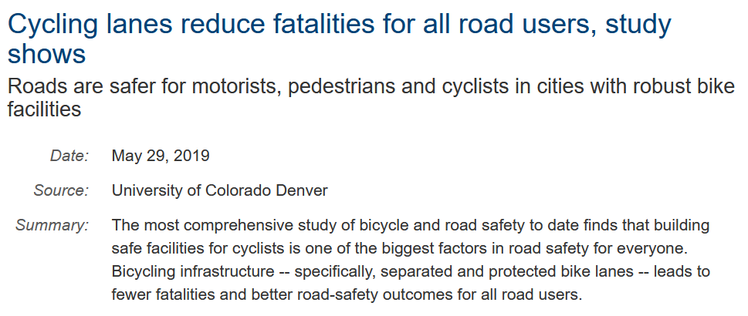
Why protected bike lanes?
Source: https://www.sciencedaily.com/releases/2019/05/190529113036.htm

Slide 7
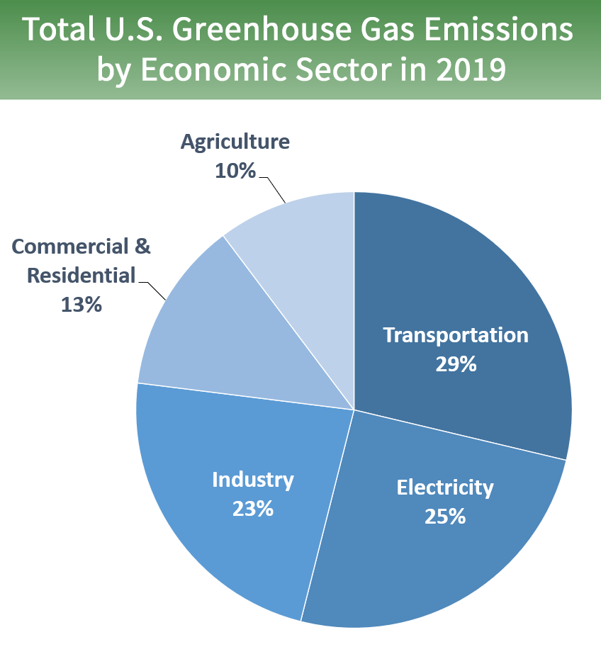
Why protected bike lanes?
Support’s our Mayor and Council’s goals
Helps reduce emission (source: EPA)
Improve safety for vulnerable road users
Source: Mayor Bower’s budget for FY2021

Slide 8
How did we get here?
2014: MoveDC called for a special study of the boarder area between NW and NE.
2016: “Crosstown Multimodal Transportation Study” completed
A major finding of the Crosstown Study was community requests from the community for protected bike lanes on Park Pl, Warder, and Kenyon.
2017-2018: Phase I Crosstown protected bike lanes (PBL) design & planning
2019: Phase I Crosstown PBLs implemented on Irving and Kenyon
2020-2021: Phase II Crosstown PBLs on Park, Warder, and Kenyon design & planning
Fall 2021: Updated Traffic Data Collection completed on Kenyon
Fall 2021: Work started on Warder
Spring 2022: Work on Park Pl, Park Rd
Fall 2022: Work on Kenyon St NW

Slide 9
Community Engagement
Extensive community engagement for MoveDC
Community engagement for Crosstown Study:
Interagency Meeting (May 15, 2018)
Public Open House (June 12, 2018)
Interagency Meeting (August 29, 2018)
Pop-up Event (September 21, 2018)
Parkview UNC (November 7, 2018)
Presentations to ANC 1A on Crosstown Phase II:
November 12th, 2020
January 26th,2021
May 20th, 2021
September 28th, 2021
November 23rd, 2021
Received 46 email comments

Slide 10
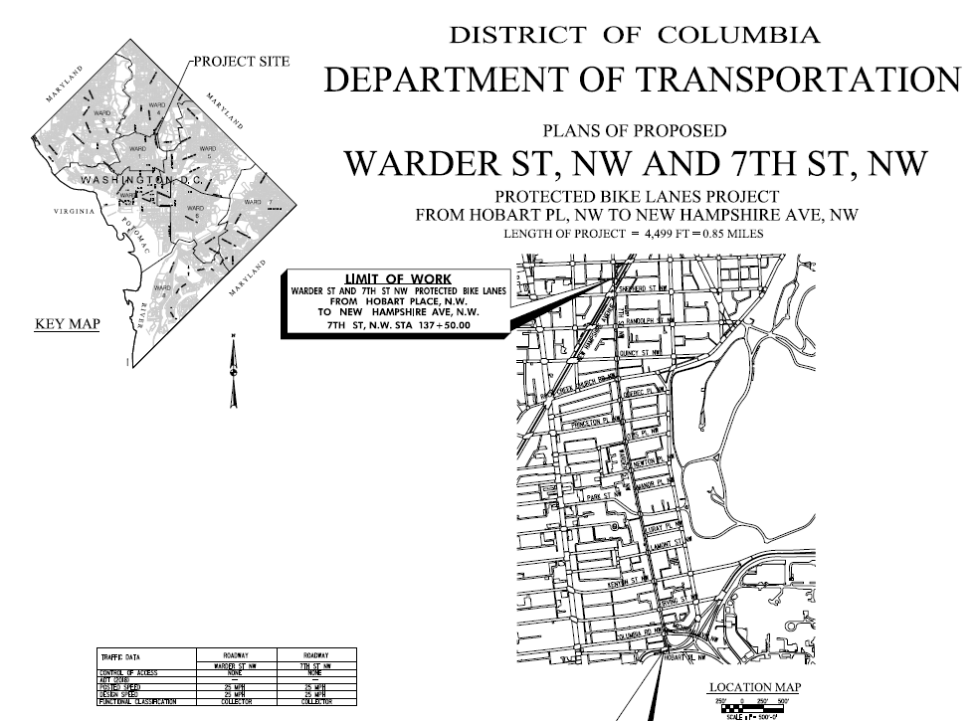
Warder Update
NOI closed on 8/16/21
Tree pit excavation complete
Repaving to end in early April
Protected bike lane to be installed in mid April
Trees to be planted in late April

Slide 11
Crosstown Phase II Map
Existing protected bike lanes
New protected bike lanes
One-way conversion (westbound)
Streets planned for freight and transit (bus)
Warder
Park Pl
Park Rd
Kenyon
Irving
Columbia
5th St.

Slide 12
How to Get in Touch
Aaron Goldbeck
Bicycle Program Specialist
Planning & Sustainability Division District Department of Transportation 250 M Street SE, Suite 500 Washington, DC 20003
e. aaron.goldbeck@dc.gov
w. ddot.dc.gov
w. https://www.dccycletrack.com/crosstown

